Slide 1

INNOVATION AND Self DRIVING CARS

Slide 2


Slide 3

Light Bulb

Slide 4
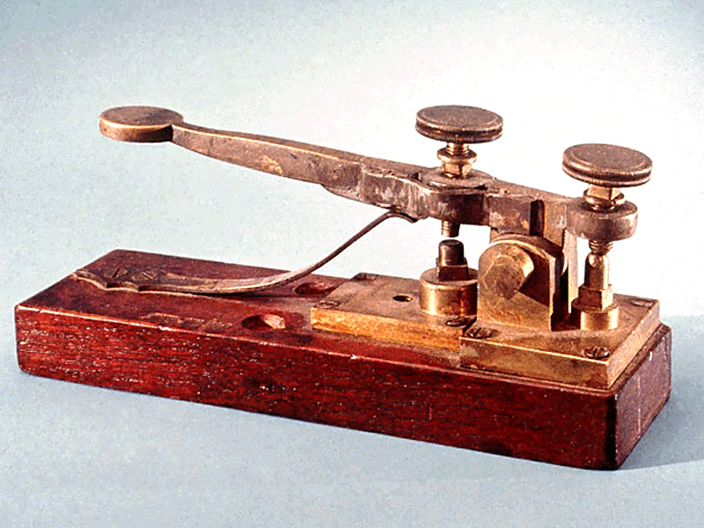
TELEGRAPH

Slide 5

COMPUTER

Slide 6
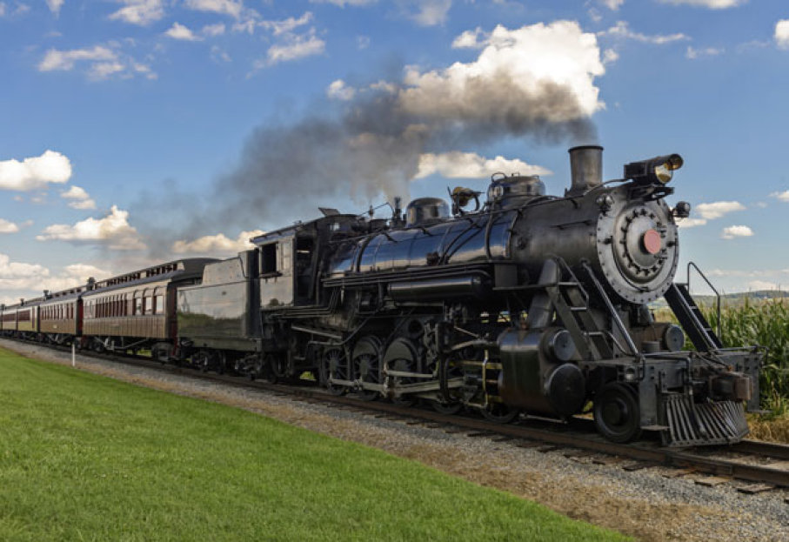
STEAM ENGINE

Slide 7
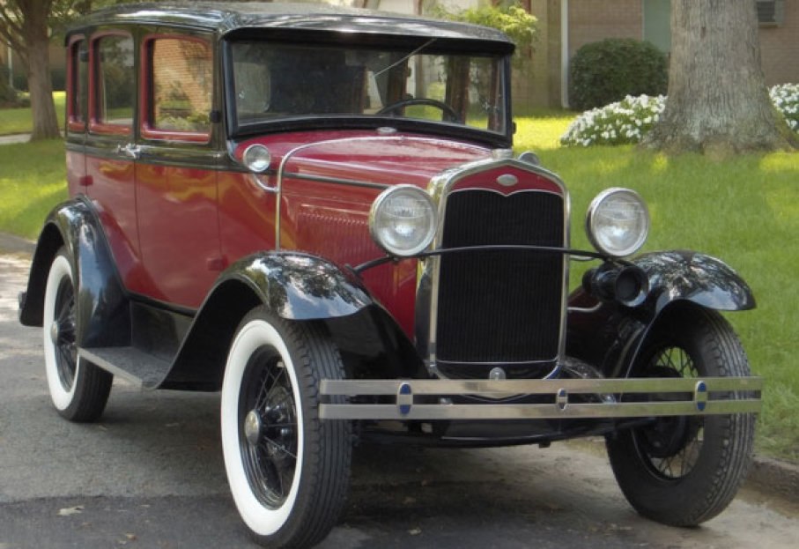
AUTOMOBILE

Slide 8
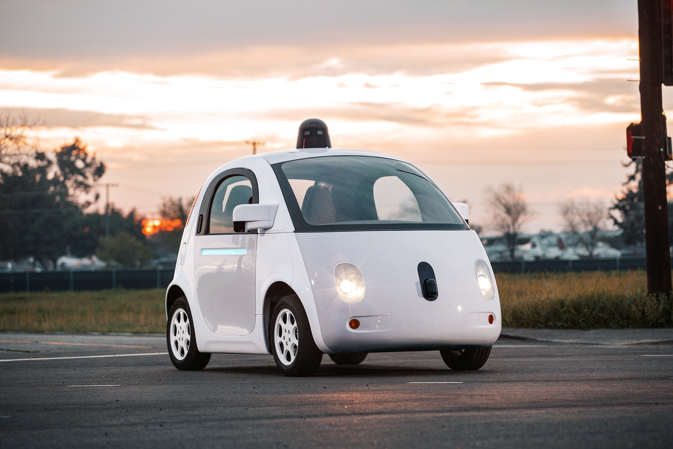
SELF DRIVING CAR

Slide 9


Slide 10

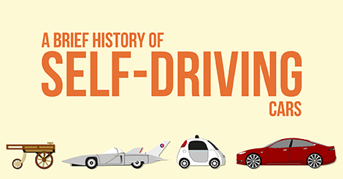

Slide 11
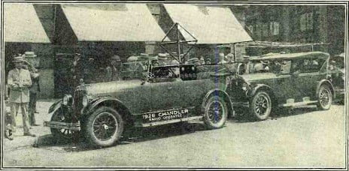
THE DRIVERLESS DREAM BEGINS

Slide 12
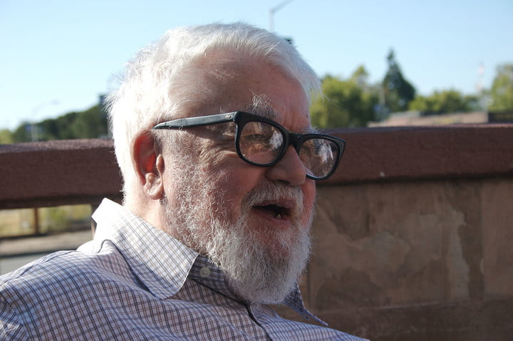
JOHN MCCARTHY’S ROBO-CHAUFFEUR

Slide 13
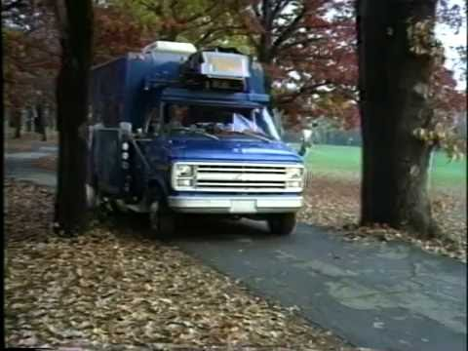
NO HANDS ACROSS AMERICA

Slide 14
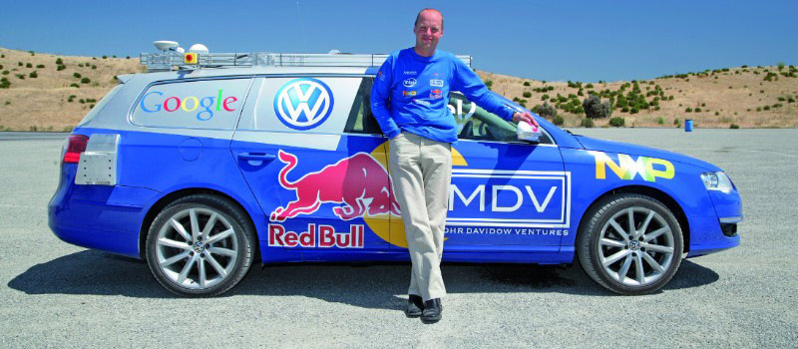
THE GRAND CHALLENGE IS TOO CHALLENGING

Slide 15
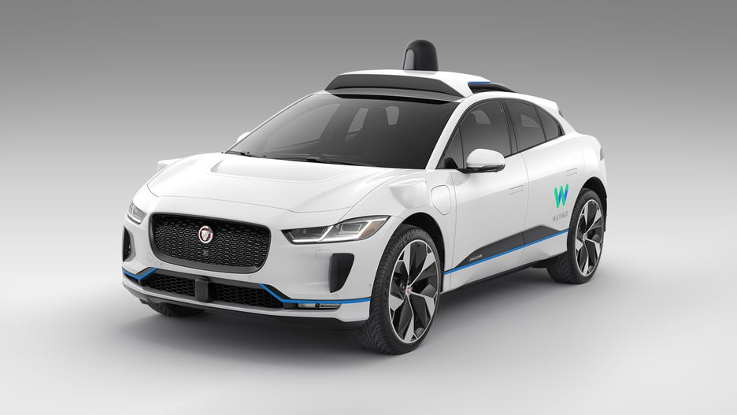
GOOGLE SEARCHES FOR AN ANSWER

Slide 16
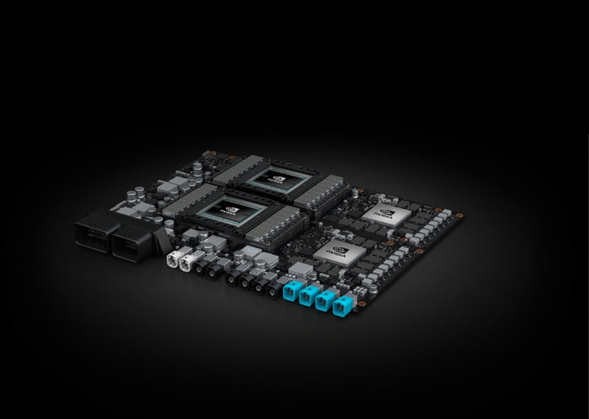
AI COMES TO SELF-DRIVING CARS

Slide 17
Autonomy LEVELS
Level 0
Level 1
Level 2
Level 3
Level 4
Level 5
No automation
Limited driver assistance
Driver-assist systems
Autonomous mode in certain situations
autonomous mode most of the times
Fully autonomous

Slide 18
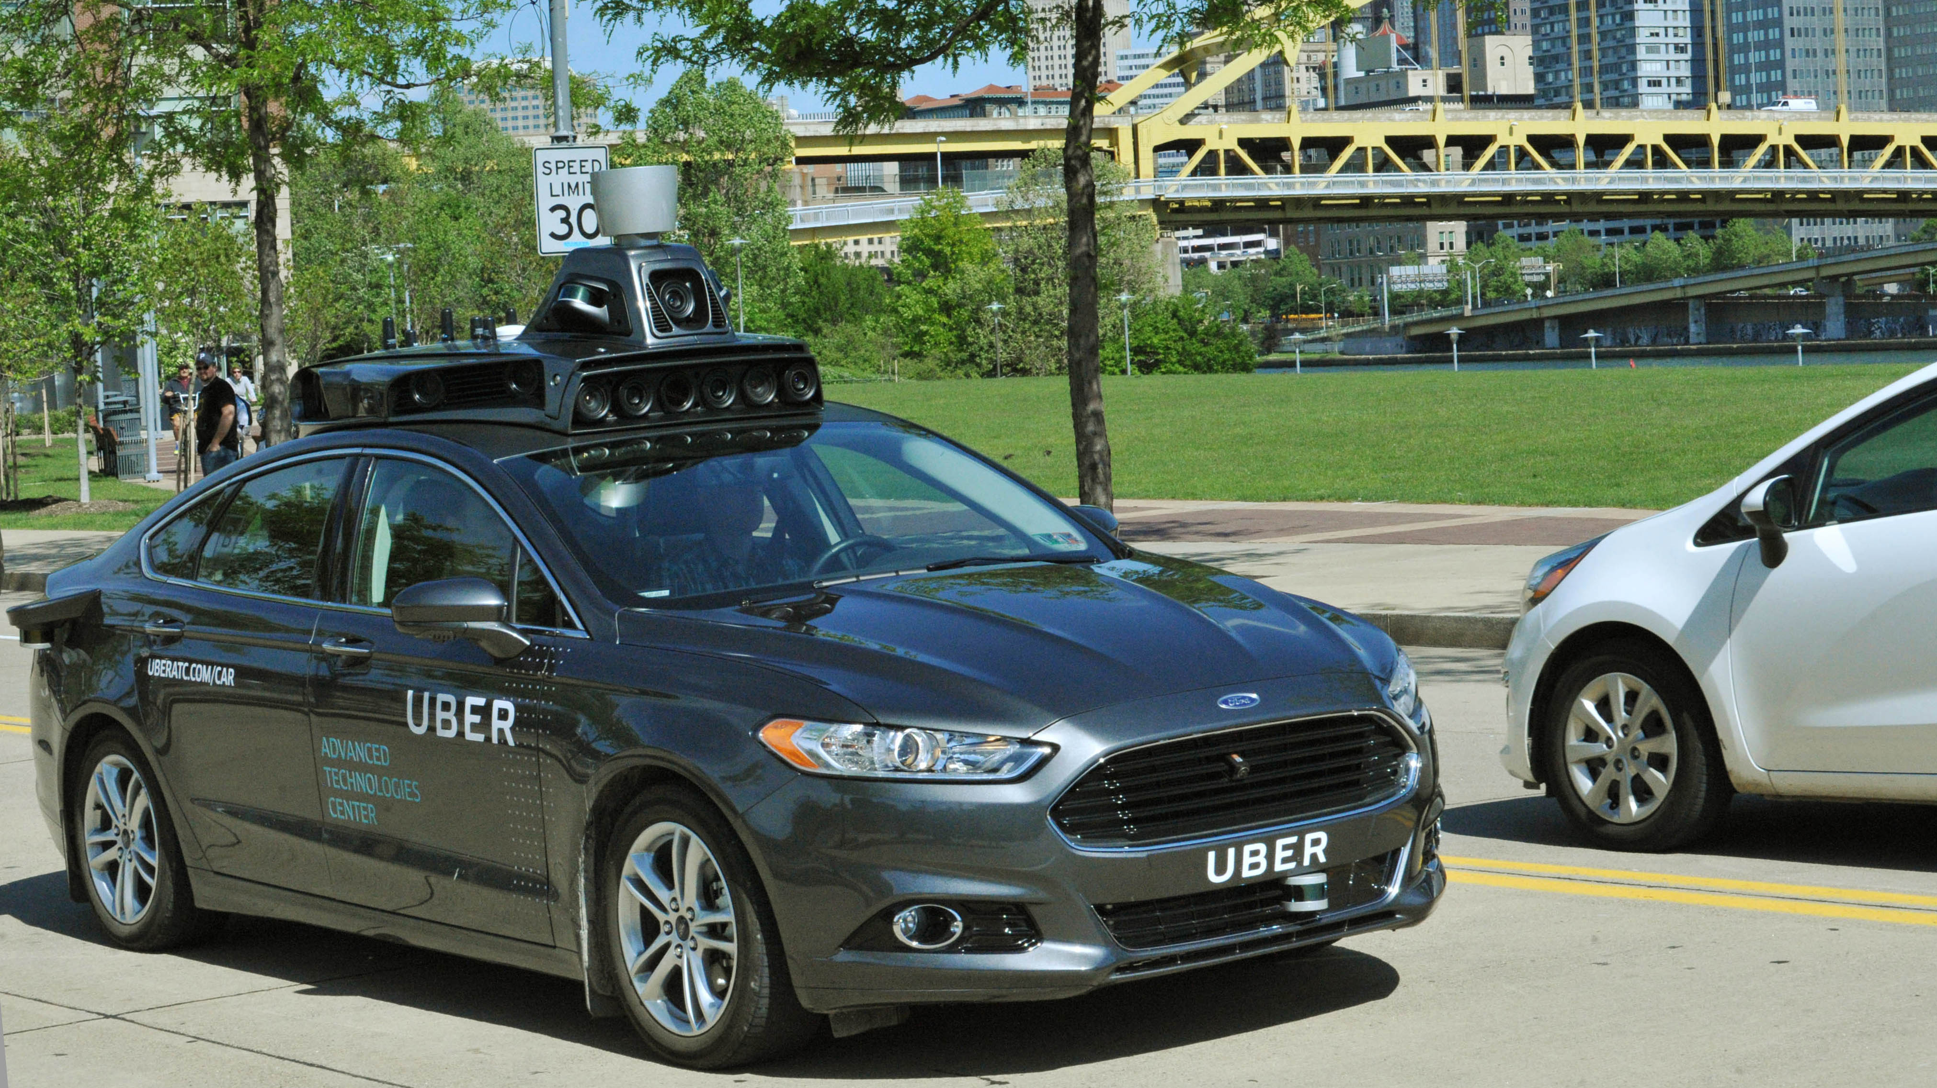
How a car drives itself

Slide 19
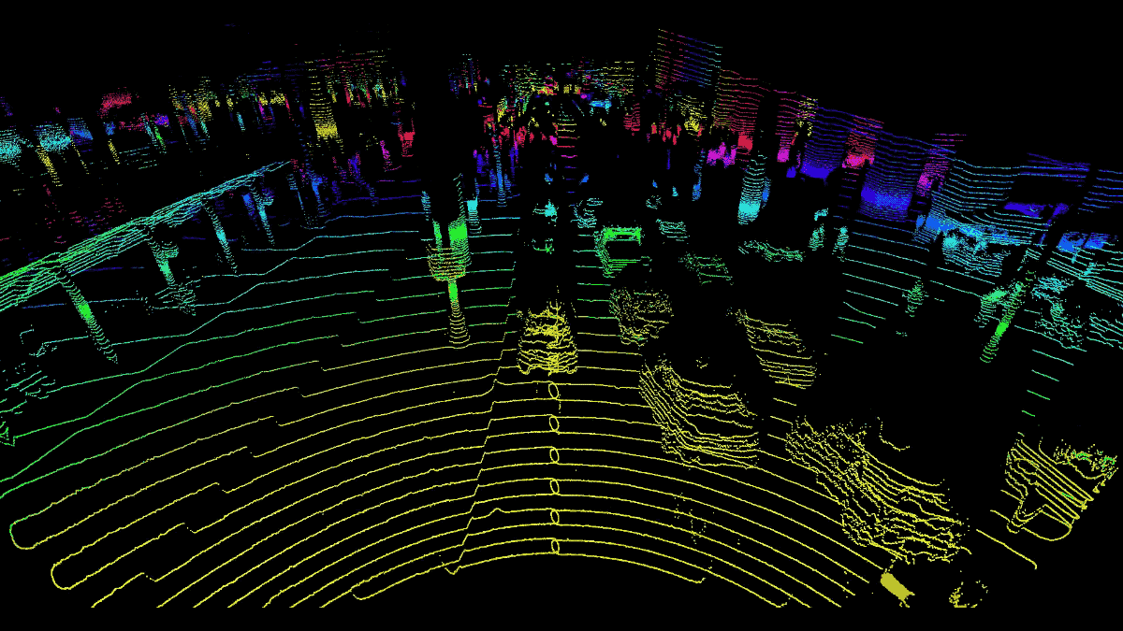

Lidar

Slide 20
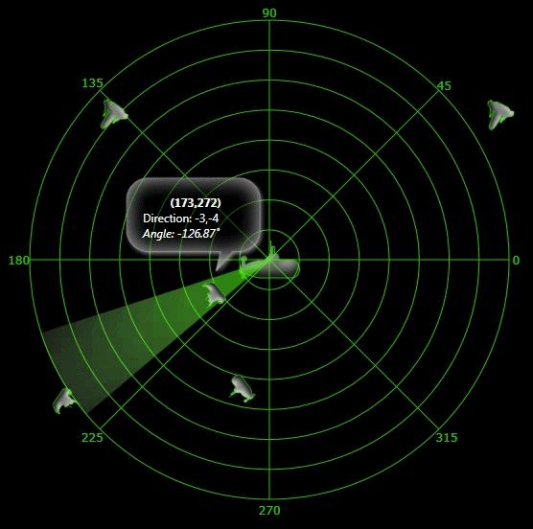

radar

Slide 21
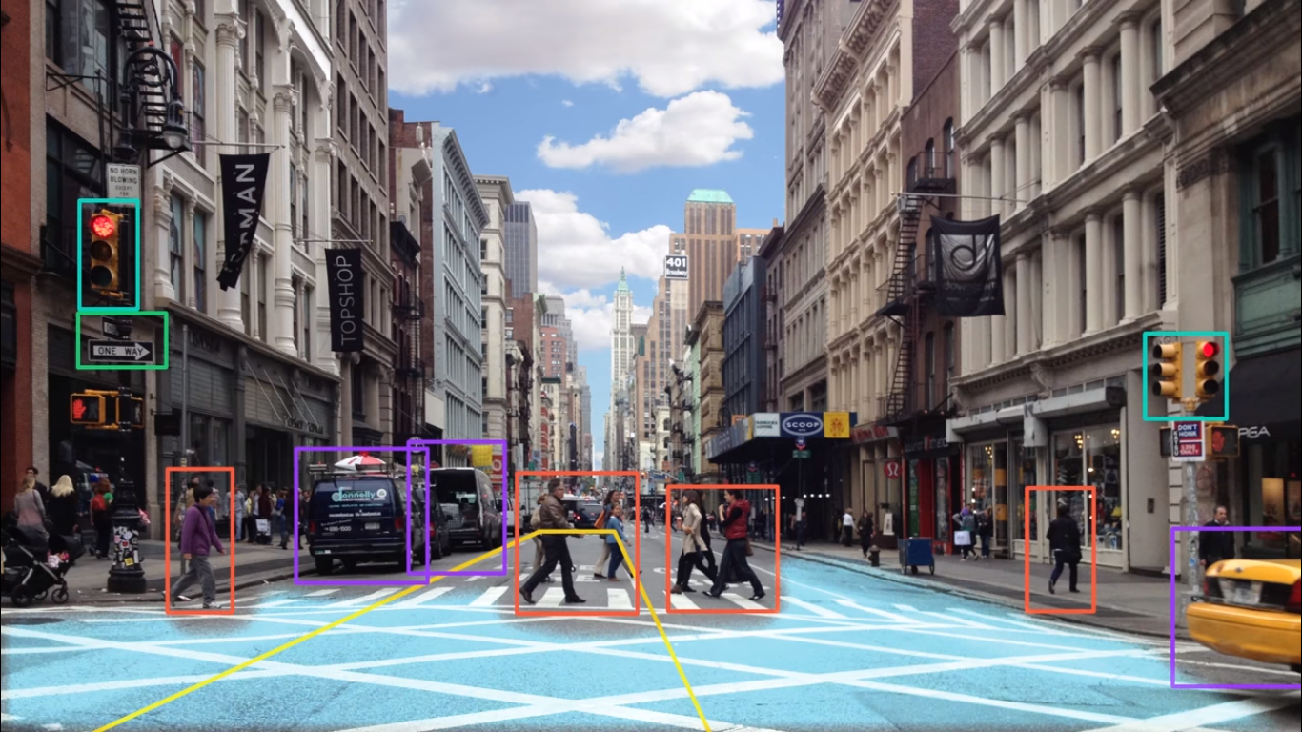
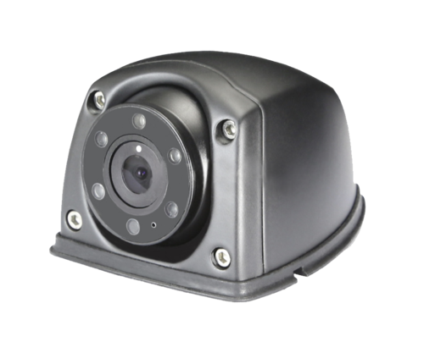
Camera

Slide 22
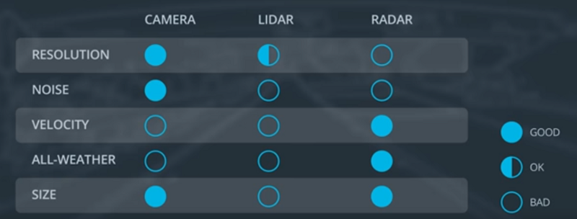
Sensor Comparison Chart

Slide 23
Autonomous Vehicle System Architecture
Sensors
Perception
Planning
Control
Camera
Radar
Lidar
GPS
Others
Detection
Route Planning
Behavior Planning
Localization
Trajectory Planning

Slide 24
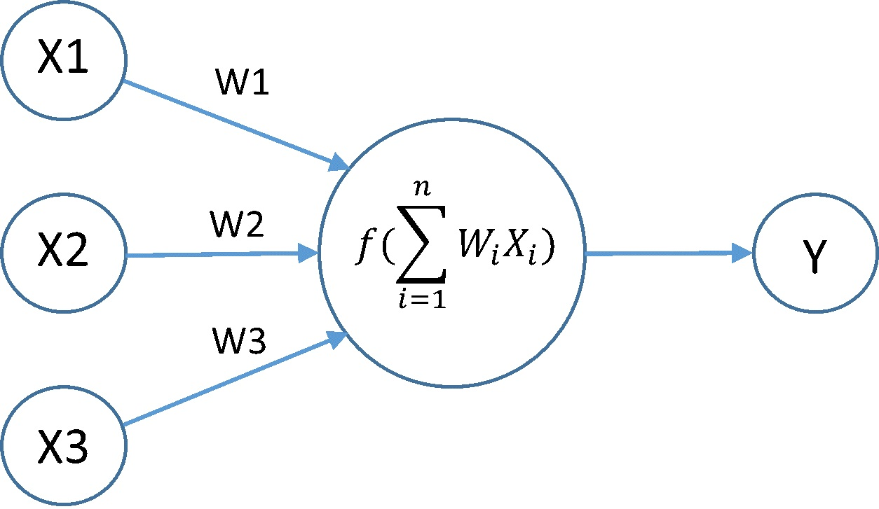
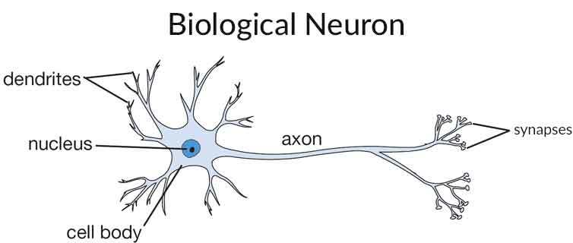
What does Artificial Intelligence (A.I.) mean ?
Artificial intelligence (AI) is an area of computer science that emphasizes the creation of intelligent machines that work and react like humans.

Slide 25
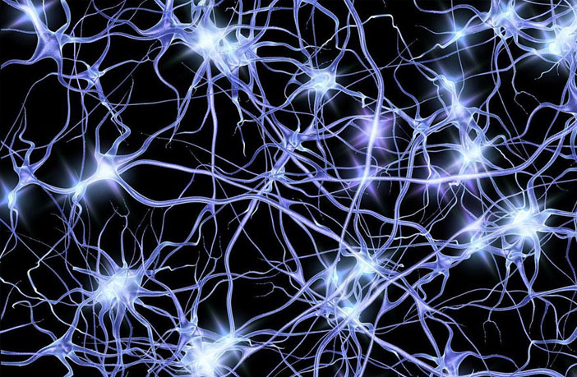
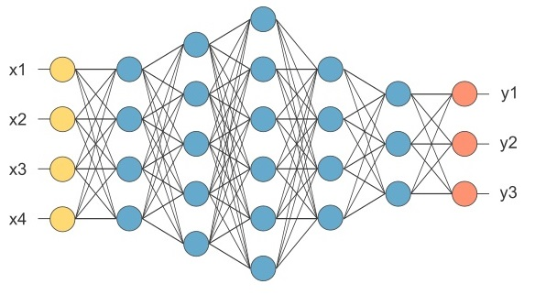
Neural Network
Neurons in Human Body
Neurons in Computer World

Slide 26
Pros and Cons
make our road safer
free up people’s time
improve mobility for everyone
expensive technology
computer malfunction could cause crashes
ethical problem

Slide 27
What Next ?

Slide 28
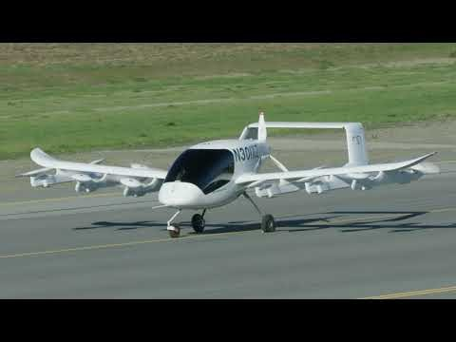

Slide 29
Mark my words: a combination airplane and motorcar is coming. You may smile, but it will come.
Henry Ford - 1940

Slide 30
Any Questions ?

Slide 31
Thank-you

